Slide 1
Ajax
26 Jun 18 | Start
27 Jun 18 | 1: 4-12
01 Jul 18 | 1: 13-14
Appendix
Online

Slide 2
Ajax
Ch | Date
1 | 00 May 18
2
3
4
5
6
7
8
Ajax The Definitive Guide 01 2008

Slide 3
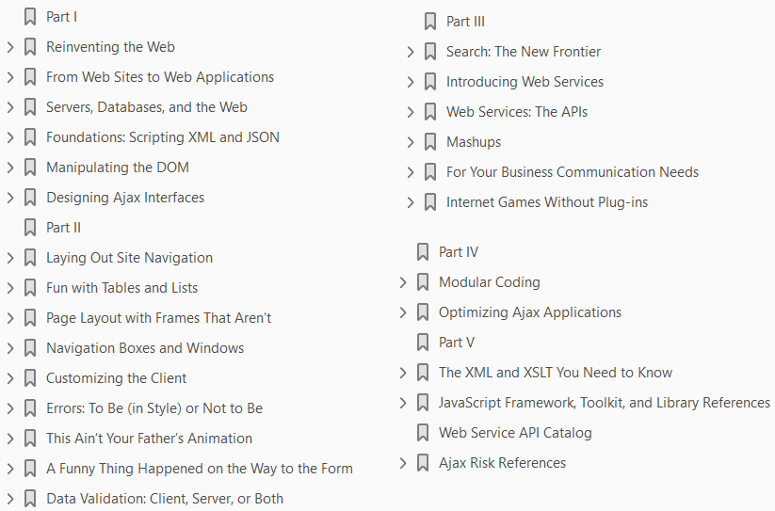

Slide 4
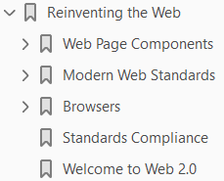
1
Reinventing the Web

Slide 5
Intro
Back in 1996, the Web was incredibly exciting, but not a whole lot was actually happening on web pages.
Programming a web page in 1996 often meant
working with a static page, and
maybe a bit of scripting helped manage a form on that page
That scripting usually came in the form of
a Perl or
C Common Gateway Interface (CGI) script, and
it handled basic things such as
authorization
page counters
search queries, and
Advertising
The most dynamic features on the pages were
the updating of a counter or time of day, or
the changing of an advertising banner when a page reloaded

Slide 6
Intro |
Applets were briefly
the rage for supplying a little chrome to your site, or
maybe some animated GIF images to break the monotony of text on the page
Thinking back now, the Web at that time was really a boring place to surf.
But look at what we had to use back then.
HTML 2.0 was the standard, with HTML 3.2 right around the corner.
You pretty much had to develop for
Internet Explorer 3.0 or
Netscape Navigator 2.1
You were lucky if someone was browsing with a resolution of 800 × 600, as 640 × 480 was still the norm.
It was a challenging time to make anything that felt truly cool or creative.
Since then,
tools
Standards
hardware technology, and

Slide 7
Intro ||
browsers have changed so much that it is difficult to draw a comparison between what the Web was then and what it is today
Ajax’s emergence signals
the reinvention of the Web, and
we should take a look at just how much has changed

Slide 8
Web Page Components
When a carpenter goes to work every day, he takes all of his work tools:
Hammer
Saw
Screwdrivers
tape measure, and more
Those tools, though, are not what makes a house.
What makes a house are the materials that go into it:
concrete for a foundation;
wood and nails for framing;
brick, stone, vinyl, or wood for the exterior—you get the idea
When we talk about web tools, we are interested in the materials that make up
the web pages
web sites, and
web applications, not necessarily the tools that are used to build them

Slide 9
Web Page Components |
Those discussions are best left for other books that can focus more tightly on individual tools.
Here,
we want to take a closer look at these web tools (the components or materials, if you will), and
see how these components have changed over the history of the Web—especially since the introduction of Ajax

Slide 10
Classic Web Components
The tools of the classic web page are really more like
the wood-framed solid or
wattle walls of the Neolithic period
They were crude and simple, serving their purpose but leaving much to be desired.
They were a renaissance, though.
Man no longer lived the lifestyle of a nomad following a herd, and instead built permanent settlements to support hunting and farming.
In much the same way, the birth of the Web and these classic web pages was a renaissance, giving people communication tools they never had before.
The tools of the classic Web were few and simple:
HyperText Markup Language (HTML)
HyperText Transfer Protocol (HTTP)
Eventually, other things went into the building of a web page, such as
CGI scripting and
possibly even a database

Slide 11
Classic Web Components |
HTML provided everything in a web page in the classic environment.
There was
no separation of presentation from structure;
JavaScript was in its infancy at best, and
could not be used to create “dynamic HTML” through Document Object Model (DOM) manipulation, because there was no DOM
If the client and the server were to communicate, they did so using very basic
HTTP GET and
sometimes, POST calls

Slide 12
NOTE
The World Wide Web Consortium (W3C) introduced the Cascading Style Sheets Level 1 (CSS1) Recommendation in December 1996, but it was not widely adopted for some time after.
Most of the available web browsers were slow to adopt the technology.
It wasn’t until browser makers began to support CSS that it even made sense to start using the technology.

Slide 13
Ajax
Many more parts go into web sites and web applications today.
Ajax is like the materials that go into making a high-rise building.
High rises are made of steel instead of wood, and their exteriors are modern and flashy with metals and special glass.
The basic structure is still there, though (unless the building was designed by Frank Lloyd Wright); walls run parallel and perpendicular to one another at 90-degree angles, and all of the structure’s basic elements, including plumbing, electricity, and lighting, are the same—they are just enhanced.
In this way, the structure of an Ajax application is built on an underlying structure of XHTML, which was merely an extension of HTML, and so forth.
Here are what I consider to be the tools used to build Ajax web applications:
Extensible HyperText Markup Language (XHTML)
Document Object Model (DOM)
JavaScript
Cascading Style Sheets (CSS)
Extensible Markup Language (XML)

Slide 14
Ajax |
Now, obviously, other things can go into building an Ajax application, such as
Extensible Stylesheet Language Transformation (XSLT)
syndication feeds with RSS and Atom (of course)
some sort of server-side scripting (which is often overlooked when discussing Ajax in general), and
possibly a database
XHTML is the structure of any Ajax application, and yes, HTML is too, but we aren’t going to discuss older technology here.
XHTML holds everything that is going to be displayed on the client browser, and everything else works off of it.
The DOM is used to navigate all of the XHTML on the page.
JavaScript has the most important role in an Ajax application.
It is used to manipulate the DOM for the page, but more important, JavaScript creates all of the communication between client and server that makes Ajax what it is.
CSS is used to affect the look of the page, and is manipulated dynamically through the DOM.
Finally, XML is the protocol that is used to transfer data back and forth between clients and servers.

Slide 15
Case Study
You may not think that changing and adding tools would have that much of an impact on how a site functions, but it certainly does.
For a case study, I want to turn your attention to a site that actually existed in the classic web environment, and exists now as a changed Ajax web application.
Then there will be no doubt as to just how far the Web has come.
The following is a closer look at MapQuest, Inc. (http://www.mapquest.com/), how it functioned and existed in 2000, and how it functions today.

Slide 16
The application then
Most people are familiar with MapQuest, seen in Figure 1-1, and how it pretty much single-handedly put Internet mapping on the map (no pun intended).
For those who are not familiar with it, I’ll give the briefest of introductions.
MapQuest was launched on February 5, 1996, delivering maps and directions based on user-defined search queries.
It has been the primary source for directions and maps on the Web for millions of people ever since (well, until Google, at least).
As MapQuest evolved, it began to offer more services than just maps and driving directions.
By 2000, it offered traffic reports, travel guides, and Yellow and White Pages as well.
How did it deliver all of these services?
The same way all other Internet sites did at the time: click on a link or search button, and you were taken to a new page that had to be completely redrawn.
The same held true for all of the map navigation. A change in the zoom factor or a move in any direction yielded a round trip to the server that, upon return, caused the whole page to refresh.
You will learn more about this client/server architecture in the section “Basic Web and Ajax Design Patterns” in Chapter 2.

Slide 17
The application then |
What you really need to note about MapQuest—and all web sites in general at the time—is that for every user request for data, the client would need to make a round trip to the server to get information.
The client would query the server, and when the server returned with an answer, it was in the form of a completely new page that needed to be loaded into the browser.
Now, this can be an extremely frustrating process, especially when navigating a map or slightly changing query parameters for a driving directions search.
And no knock at MapQuest is intended here. After all, this was how everything was done on the Internet back then; it was the only way to do things.
The Web was still in its click-wait-click-wait stage, and nothing about a web page was in any way dynamic.
Every user interaction required a complete page reload, accompanied by the momentary “flash” as the page began the reloading process.
It could take a long time for these pages to reload in the browser—everything on the page had to be loaded again.
This includes all of the background loading of CSS and JavaScript, as well as images and objects.
Figure 1-2 illustrates the flow of interaction on the Web as it was in 2000.

Slide 18
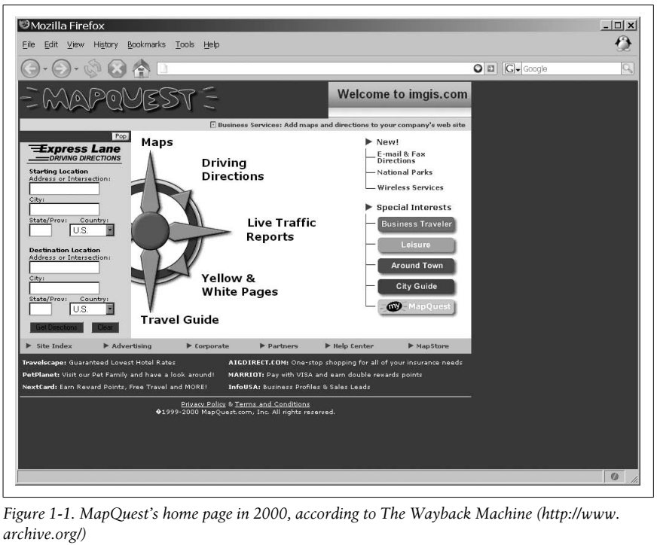
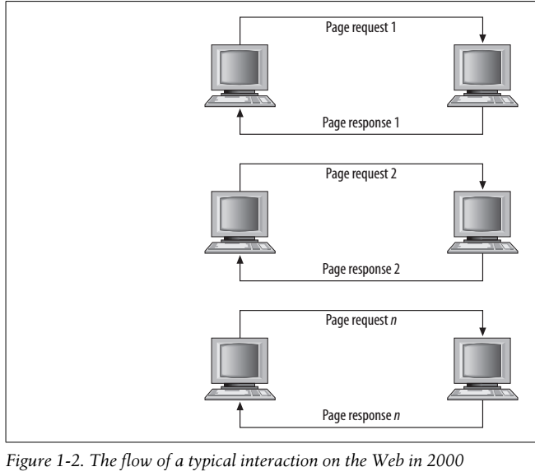
Figure 1-1 || 1-2

Slide 19
The application now
In 2005, when Google announced its version of Internet mapping, Google Maps, everything changed both for
the mapping industry and
for the web development industry in general
The funny thing was that Google was not using any fancy new technology to create its application.
Instead, it was drawing on tools that had been around for some time:
(X)HTML
JavaScript, and
XML
Soon after, all of the major Internet mapping sites had to upgrade, and had to
implement all the cool features that Google Maps had, or
they would not be able to compete in the long term
MapQuest, shown in Figure 1-3, did just that.
Now, when you’re browsing a map, the only thing on the page that refreshes when new data is requested is the map itself. It is dynamic.
This is also the case when you get driving directions and wish to add another stop to your route.

Slide 20
The application now |
This is also the case when you get driving directions and wish to add another stop to your route.
The whole page does not refresh, only the map does, and the new directions are added to the list.
The result is a more interactive user experience.
Ajax web applications remove the click-wait-click-wait scenario that has plagued the Web for so long.
Now, when you request information, you may still perform other tasks on the page while your request (not the whole page) loads.
All of this is done by using the Ajax tools discussed earlier, in the “Ajax” section of this chapter, and the standards that apply to them.
After reading the section “Standards Compliance,” later in this chapter, you will have a better idea of why coding to standards is important, and what it means when a site does not validate correctly (MapQuest, incidentally, does not).
Figure 1-4 shows how Ajax has changed the flow of interaction on a web page.
The addition of Ajax as a tool to use in web applications allows a developer to make user interaction more similar to that of a desktop application.
Flickering as a page is loaded after user interaction goes away.

Slide 21
The application now ||
The user will perceive everything about the web application as being self-contained.
With this technology a savvy developer can make an application function in virtually the same way, whether on
the Web or
on the desktop

Slide 22
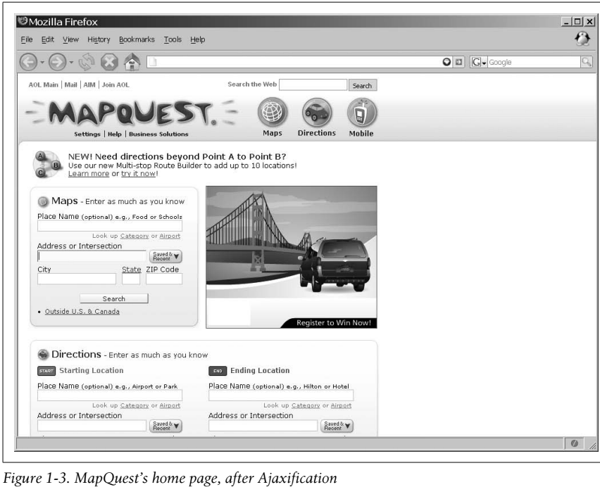
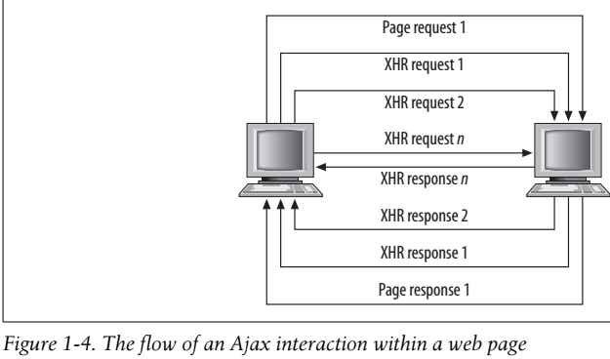
Figure 1-3 || 1-4

Slide 23
NOTE
Jesse James Garrett coined the term Ajax in February 2005 in his essay,
“Ajax: A New Approach to Web Applications” (http://www.adaptivepath.com/publications/essays/archives/000385.php)
Although he used Ajax, others began using the acronym AJAX (which stands for Asynchronous JavaScript and XML).
I prefer the former simply because the X for XML is not absolutely necessary for Ajax to work;
JavaScript Object Notation (JSON) or
plain text could be used instead

Slide 24
Modern Web Standards
Web standards: these two words evoke different feelings in different people.
Some will scoff and roll their eyes
some will get angry and declare the need for them, and
some will get on a soapbox and preach to anyone who will listen
Whatever your view is, it is time to reach a common ground on which everyone can agree.
The simple fact is that web standards
enable the content of an application to be made available to a much wider range of people and technologies
at lower costs and faster development speeds
In the earlier years of the Web, the browser makers were to blame for difficulties in adopting web standards.
Anyone that remembers the days of the 4.0 browsers, more commonly referred to as the “Browser Wars,” will attest to the fact that nothing you did in one environment would work the same in another.
No one can really blame Netscape and Microsoft for what they did at the time.
Competition was stiff, so why would either of them want to agree on common formats for markup, for example?

Slide 25
Modern Web Standards |
This is no longer the case.
Now developers are to blame for not adopting standards.
Some developers are stuck with the mentality of the 1990s, when
browser quirks mode
coding hacks, and
other tricks were the only things that allowed code to work in all environments
Also at fault is “helpful” What You See Is What You Get (WYSIWYG) software that still generates code geared for 4.0 browsers without any real thought to
document structure
web standards
separating structure from presentation, and so forth

Slide 26
Standards Bodies
Now several standards bodies provide
the formal standards and
technical specifications we all love and hold dear to our hearts
For our discussion on standards, we will be concerning ourselves with
the W3C (http://www.w3.org)
Ecma International (formerly known as ECMA; http://www.ecma-international.org/), and
the Internet Engineering Task Force (IETF; http://www.ietf.org)
These organizations have provided some of the standards we web developers use day in and day out, such as
XHTML CSS
JavaScript the DOM
XML XSLT
RSS, and Atom
Not only does Ajax use each standard, but also these standards are either the fundamental building blocks of Ajax or may be used in exciting ways with Ajax web applications.

Slide 27
NOTE
Using the standards that have been published on the Web (and making sure they validate) satisfies the following Web Accessibility Initiative-Web Content Accessibility Guidelines (WAI-WCAG) 1.0 guideline:
Priority 2 checkpoint 3.2: Create documents that validate to published formal grammars.

Slide 28
XHTML
On January 26, 2000, the W3C published “XHTML 1.0: The Extensible HyperText MarkUp Language,” a reformulation of HTML 4.01 as XML.
Unfortunately, even today XHTML 1.0 is still not incorporated in a vast majority of web sites.
It may be that people are taking the “if it ain’t broke, don’t fix it” mentality when it comes to changing their markup from HTML 4.01 to XHTML 1.0, it may be that people just
do not see the benefits of XML, or
it may be, as is especially true in corporate environments, that there is simply no budget to change sites that already exist and function adequately
Even after a second version of the standard was released on August 1, 2002, incorporating the errata changes made to that point, it still was not widely adopted.
On May 31, 2001, even before the second version of XHTML 1.0 was released, the W3C introduced the “XHTML 1.1—Module-based XHTML Recommendation.”
This version of XHTML introduced the idea of a modular design, with the intention that you could add other modules or components to create a new document type without breaking standards compliance (though it would break XHTML compliance); see Example 1-1.

Slide 29
XHTML |
All deprecated features of HTML (presentation elements, framesets, etc.) were also completely removed in XHTML 1.1.
This, more than anything, slowed the adoption of XHTML 1.1 in the majority of web sites, as few people were willing to make the needed changes
redesigning site layout without frames and adding additional attributes to elements
not to mention removing presentation and placing that into CSS
Contributing to XHTML 1.1’s lack of deployment is the fact that it is not backward-compatible with
XHTML 1.0 and
HTML

Slide 30
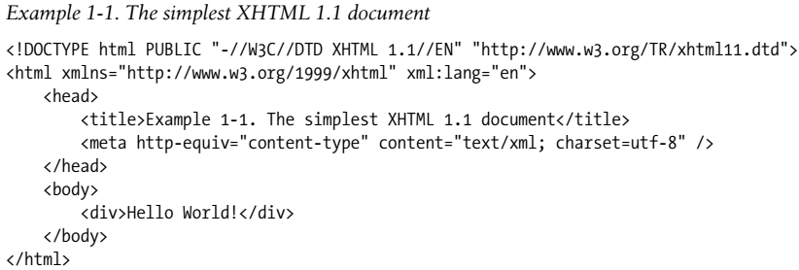
Example 1-1

Slide 31
XHTML Potential
Although the vast majority of web sites out there are not following the XHTML 1.1 Recommendation, it has tremendous potential for certain key areas.
The development of new applications on the Web, and the use of those applications on different platforms such as
mobile and
wireless devices, is leading to a greater rate of adoption than when XHTML 1.1 was first published
For this reason, I believe it is important to recognize the power and potential of XHTML 1.1.
Therefore, we will follow this standard in nearly every example in this book (see Chapters 20 and 21 for different standards usage).
With that said, we must be mindful that the future of web application development is being proposed right now.
Already the W3C has a working draft for an XHTML 2.0 specification.
In XHTML 2.0,
HTML forms are replaced with XForms
HTML frames are replaced with XFrames, and
DOM Events are replaced with XML Events

Slide 32
XHTML Potential |
It builds on past recommendations, but when the XHTML 2.0 Recommendation is published, it will define the beginning of a new era in web development.
You should note that XHTML 2.0 is not designed to be backward-compatible.
Development taking advantage of this recommendation will most likely be geared toward more specialized audiences that have the ability to view such applications, and not the general public.
It will be some time before this recommendation gets its feet off the ground, but I felt that it was worth mentioning.
You can find more information on the XHTML family of recommendations at http://www.w3.org/MarkUp/.

Slide 33
The New Kid on the Block?
The Web Hypertext Application Technology Working Group (WHATWG) announced its arrival June 4, 2004.
Its mission, according to its web site, is “to develop specifications based on HTML and related technologies to ease the deployment of interoperable Web Applications, with the intention of submitting the results to a standards organization.”
The group was formed with the idea of creating a single development environment on which web applications are built.
To that end, it is publishing technical specifications intended for implementation in what it calls “mass-market web browsers” such as
Safari Mozilla, and Opera
Its current work, now proceeding jointly with the W3C, is HTML 5.
HTML 5 abandons the strictness of XML that XHTML had adopted, and focuses on adding new features to HTML itself.
Added elements include nav, article, aside, section, header, footer, mark, time, meter, progress, figure, dialog, datagrid, details, menu, command, and more.
HTML 5 is currently only a draft specification, and is not available in browsers.

Slide 34
JavaScript
Netscape Communications Corporation’s implementation of ECMAScript, now a registered trademark of Sun Microsystems, Inc., is JavaScript.
It was first introduced in December 1995.
In response, Microsoft developed its own version of the ECMA standard, calling it JScript.
This confused a lot of developers, and at the time it was thought to contribute to the incompatibilities among web browsers.
These incompatibilities, however, are more likely due to differences in DOM implementation rather than JavaScript or its subset, ECMAScript.
The European Computer Manufacturer’s Association (ECMA) International controls the recommendations for ECMAScript.
JavaScript 1.5 corresponds to the ECMA-262 Edition 3 standard that you can find at http://www.ecma-international.org/publications/standards/Ecma-262.htm.
As of 2009, the latest implemented version of JavaScript is 1. 9, which builds upon all of its predecessors (1.5 through 1.8.1) - all of which correspond to ECMA-262 Edition 3 starting at 1.5.
This latest addition includes ECMAScript 5 compliance, and is projected to first be seen in Mozilla Firefox 4.
JavaScript technically does not comply with ECMA International standards.

Slide 35
JavaScript |
Mozilla has JavaScript
Internet Explorer has JScript, and
Opera and Safari have other ECMAScript implementations
though it should be noted that Mozilla is closer to standards than Internet Explorer is
Most of these browsers have now implemented to at least JavaScript 1.7, with the exception being Internet Explorer and surprisingly, Opera, who have still only implemented to JavaScript 1.5.
For this reason all code examples, unless otherwise noted, are based on this version.

Slide 36
The DOM
The Document Object Model, a Level 2 specification built onto the existing DOM Level 1 specification, introduced modules to the specification.
The
Core
View
Events
Style, and
Traversal and Range modules were introduced on November 13, 2000
The HTML module was introduced on January 9, 2003.
The DOM Level 3 specification built onto its predecessor as well.
The modules changed around somewhat, but what this version added to DOM Level 2 was greater functionality to work with XML.
This was an important specification, as it adds to the functionality of Ajax applications as well.
The Validation module was published on December 15, 2003.

Slide 37
The DOM |
The modules
Core and
Load and Save were published on April 7, 2004
Not all of the modules for DOM Level 3 have become recommendations yet, and because of that they bear watching.
The Abstract Schemas module has been a note since July 25, 2002;
Events has been a working group note since November 7, 2003 (though it was updated April 13, 2006);
XPath has been a working group note since February 24, 2004; and
Requirements and Views and Formatting have been working group notes since February 26, 2004
These modules will further shape the ways in which developers can interact with the DOM, subsequently shaping how Ajax applications perform as well.
The W3C’s DOM Technical Reports page is located at http://www.w3.org/DOM/DOMTR.

Slide 38
Cascading Style Sheets (CSS)
The W3C proposed the “Cascading Style Sheets Level 2(CSS2) Recommendation” on May 12, 1998. Most modern browsers support most of the CSS2 specifications, though there are some issues with full browser support, as you will see in the “Browsers” section, later in this chapter. The CSS2specification was built onto the “Cascading Style Sheets Level 1 (CSS1) Recommendation,” which all modern browsers should fully support. Because of poor adoption by browsers of the CSS2Recommendation, the W3C revised CSS2 with CSS2.1 on August 2, 2002. This version was more of a working snapshot of the current CSS support in web browsers than an actual recommendation. CSS2.1 became a Candidate Recommendation on February 24, 2004, but it went back to a Working Draft on June 13, 2005 to fix some bugs and to match the current browser implementations at the time. Browsers are working toward full implementation of the CSS2.1 standard (some more than others), even though it is still a working draft, mainly so that when the newer Cascading Style Sheets Level 3 (CSS3) finally becomes a recommendation they
(Page 13).

Slide 39
XML
XML is the general language for describing different kinds of data, and it is one of the main data transportation agents used on the Web. The W3C’s XML 1.0 Recommendation is now in its fifth edition: the first was published on February 10, 1998 while the latest edition was published on November 26, 2008. At the same time as edition three was being released (February 4, 2004), the W3C also published the XML 1.1 Recommendation, which gave consistency in character representations and relaxed names, allowable characters, and end-of-line representations. The second edition of XML 1.1 was published on September 29, 2006. Though both XML 1.0 and XML 1.1 are considered current versions, this book will not need anything more than XML 1.0. People like XML for use on the Web for a number of reasons. It is self-documenting, meaning that the structure itself defines and describes the data within it. Because it is plain text, there are no restrictions on its use, an important point for the free and open Web. And both humans and machines can read it without altering the original structure and data. You can find more on XML at http://www.w3.org/XML/. Even though Ajax is no longer an acronym and the X in AJAX is now just an x, XML is still an important structure to mention when discussing Ajax applications. It may not be the transportation mode of choice for many applications, but it may still be the foundation for the data that is being used in those applications by way of syndication feeds.
(Page 14).

Slide 40
Syndication
The type of syndication that we will discuss here is, of course, that in which sections of a web site are made available for other sites to use, most often using XML as the transport agent. News, weather, and blog web sites have always been the most common sources for syndication, but there is no limitation as to where a feed can come from. The idea of syndication is not new. It first appeared on the Web around 1995 when R. V. Guha created a system called Meta Content Framework (MCF) while working
(Page 14).

Slide 41
RSS
RSS is not a single standard, but a family of standards, all using XML for their base structure. Note that I use the term standard loosely here, as RSS is not actually a standard. (RDF, the basis of RSS 1.0, is a W3C standard.) This family of standards for syndication feeds has a sordid history, with the different versions having been created through code forks and disagreements among developers. For the sake of simplicity, the only version of RSS that we will use in this book is RSS 2.0, a simple example of which you can see in Example 1-2.
(Page 15).

Slide 42
Atom
Because of all the different versions of RSS and resulting issues and confusion, another group began working on a new syndication specification, called Atom. In July 2005, the IETF accepted Atom 1.0 as a proposed standard. In December of that year, it published the Atom Syndication Format protocol known as RFC 4287 (http:// tools.ietf.org/html/4287). An example of this protocol appears in Example 1-3. There are several major differences between Atom 1.0 and RSS 2.0. Atom 1.0 is within an XML namespace, has a registered MIME type, includes an XML schema, and undergoes a standardization process. By contrast, RSS 2.0 is not within a namespace, is often sent as application/rss+xml but has no registered MIME type, does not have an XML schema, and is not standardized, nor can it be modified, as per its copyright.
(Page 16).

Slide 43
XSLT
XSLT is an XML-based language used to transform, or format, XML documents. On November 16, 1999, XSLT version 1.0 became a W3C Recommendation. As of January 23, 2007, XSLT version 2.0 is a Recommendation that works in conjunction with XPath 2.0. (Most browsers currently support only XSLT 1.0 and XPath 1.0.) XSLT uses XPath to identify subsets of the XML document tree and to perform calculations on queries. We will discuss XPath and XSLT in more detail in Chapter 5. For more information on the XSL family of W3C Recommendations, visit http:// www.w3.org/Style/XSL/. XSLT takes an XML document and creates a new document with all of the transformations, leaving the original XML document intact. In Ajax contexts, the transformation usually produces XHTML with CSS linked to it so that the user can view the data in his browser.
(Page 17).

Slide 44
Browsers
Like standards, browsers can be a touchy subject for some people. Everyone has a particular browser that she is comfortable with, whether because of features, simplicity of use, or familiarity. Developers need to know, however, the differences among the browsers—for example, what standards they support. Also, it should be noted that it’s not the browser, but rather the engine driving it that really matters. To generalize our discussion of browsers, therefore, it’s easiest to focus on the following engines: • Gecko • Trident • KHTML/WebKit • Presto Table 1-1 shows just how well each major browser layout engine supports the standards we have discussed in this chapter, as well as some that we will cover later in the book.
(Page 17).

Slide 45
Gecko
Gecko is the layout engine built by the Mozilla project and used in all Mozilla-branded browsers and software. Some of these products are Mozilla Firefox, Netscape, and K-Meleon. One of the nice features of Gecko is that it is cross-platform by design, so it runs on several different operating systems, including Windows, Linux, and Mac OS X.
(Page 18).

Slide 46
Trident
Trident is the layout engine that Internet Explorer (Windows versions only) has used since version 4.0, and it is sometimes referred to as MSHTML. AOL Explorer and Netscape use it as well (Netscape can use either Gecko or Trident).
(Page 18).

Slide 47
KHTML/WebKit
KHTML is the layout engine developed by the KDE project. The most notable browsers that use KHTML are KDE Konqueror and Apple’s Safari, though Safari uses a variant called WebKit, which Google’s Chrome and OmniWeb also use..
(Page 18).

Slide 48
Presto
Presto is the layout engine developed by Opera Software for the Opera web browser. The engine is also used in the Mac OS X versions of Macromedia Dreamweaver MX and later. Presto is probably the most standards-compliant browser out there today.
(Page 19).

Slide 49
Others
Other layout engines support browsers on the Web, but these browsers make up less than two percent of all browsers in use today, and maybe even less than that. These layout engines support a wide range of standards, but none of these browsers implements any standard that another one of the aforementioned layout engines does not already implement.
(Page 19).

Slide 50
Standards Compliance
So far, I have pointed out the current standards and when they were introduced, as well as which browsers support them, but I still need to answer a burning question: “Why program to standards, anyway?” Let’s discuss that now. What is one of the worst things developers have to account for when programming a site for the Internet? That answer is easy, right? Backward compatibility.
(Page 19).

Slide 51
Welcome to Web 2.0
So, what exactly do users deserve? They deserve interaction, accessibility, and functionality; but most of all, they deserve for the Web to be a platform, and Ajax is the means to that end. With Ajax, you can make the interface in the browser be just like a desktop application, and it can react faster and offer functionality that web users
(Page 20).

Slide 52
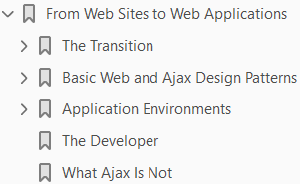
2
From Web Sites to Web Applications

Slide 53
Intro
Ajax web applications are here, and they are the future of the Web. The big question at this point is, how do we get there? How do we get from simple web sites to web applications? This seems easy on the surface, right? Unfortunately, it’s not easy. Developing an application, whether it is on the desktop or on the Web, takes more forethought than the old model of web design did. Think for a minute about the old model. Sure, you could lay out your site and know what pages you wanted linked to other pages, or maybe you could draw a simple flow diagram, but that was usually as far as it went. Need to add another page? No problem: you’d create it and stick the link for it wherever it needed to be. There is nothing wrong with this process, especially for small sites. Web sites in general are not inherently complicated, and they don’t need a more complex development model (though content management can be helpful). Application development, for the Web or otherwise, demands a more structured approach, however.
(Page 22).

Slide 54
The Transition
The art of computer science slowly begins to creep back into the Web as the application life cycle begins.
Any software developer can describe the life cycle of a software application.
If a programmer does not learn it as part of her curriculum in school, you can bet she finds out what it is very quickly on the job.
Why is this so important?
Because it is a process that is tried and true (though not necessarily followed consistently). Figure 2-1 shows a typical life cycle model. Following are the phases of software application development.
(Page 22).

Slide 55
Basic Web and Ajax Design Patterns
Design patterns! Now, before anyone gets too excited, this isn’t going to be another book that talks about the general subject of design patterns. Erich Gamma et al. did a fine job of that in the book Design Patterns (Addison-Wesley). There is a time and place for further discussions, and this isn’t it. Instead, I want to take a look at the development of the overall design pattern that defines an Ajax web application. The simplest definition of a design pattern is “the solution to a problem in generic terms.” I want to keep the discussion of an Ajax design pattern to that. Check out Ajax Design Patterns, by Michael Mahemoff (O’Reilly), for a vastly more detailed look at design patterns as they relate to specific Ajax problems and their solutions. To begin our discussion of design patterns, we’ll study the classic model of an Internet site and see how it evolved into the design pattern used today in Ajax web applications.
(Page 28).

Slide 56
Application Environments
You can implement Ajax web applications in many environments.
Each of them has special design considerations.
Understanding the environment for which the application is to be built is as important as understanding for whom the application is to be built.
(Page 31).

Slide 57
The Developer
At this point, you’ve had a little primer on Ajax web development life cycles, the basic design pattern of Ajax applications, and considerations for different environments in which your application could be used. What else do you need to know to move from building web sites to building web applications? An important bit of information to hold on to is that a web application is just that: an application. It is more complex to build, it takes more time, and it requires more skilled developers to build it right. It isn’t as simple as opening a text browser, writing some markup, and saving it with an .html extension. A web application developer has to know XHTML, CSS, JavaScript, XML, and the Document Object Model (DOM) at a minimum. Most developers also know Extensible Stylesheet Language Transformation (XSLT), and syndication techniques. And remember, this is just the client side of things. In Chapter 3, we will explore the other side of Ajax, which is the server side. A developer should also understand how the HTTP server works, one or more server-side scripting languages, and databases. Web applications require developers to know a wider variety of things than a desktop application developer would ever need to know. If people were mystified by how web sites worked before, what will they think about Ajax web applications now?
(Page 33).

Slide 58
What Ajax Is Not
Ajax is not the be-all and end-all solution to every new application being built for the Web. It is not even something that should be considered as an upgrade to every existing product. Ajax is a great model for building more modern, faster Web 2.0 applications, but only when they are built correctly. Throwing Ajax at every application can create complications, such as accessibility issues, cross-browser compliance nightmares, and requiring more intricate and complex programming to perform simple tasks. I want to make sure this is clear, before everyone gets all gung-ho and throws Ajax everywhere. Ajax is not for everything. Let me repeat that. Ajax is not for everything. Take a look at Appendix D for risks that Ajax can create. I love the Ajax model of design; I think it brings web applications closer to the capabilities of desktop applications. I also know, somewhat from experience, that Ajax is not the best solution for every project, and that it can sometimes overcomplicate what could have been a simple solution. As you read the rest of this book and you see Ajax solutions that I present to common web design issues, ask yourself whether Ajax is right for you and what you are trying to accomplish. It could fit perfectly, but it could also be the wrong solution for you after all.
(Page 34).

Slide 59
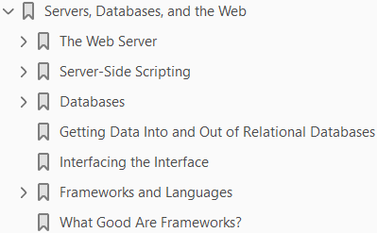
3
Servers, Databases, and the Web

Slide 60
Intro
Most of this book will be about the client side, as people think of Ajax as something that works specifically in the browser. Ajax definitely needs server support to work, though. So far, we’ve looked at the standards and technology that form the backbone of an Ajax web application, and how these applications moved away from the traditional web site model. Now, it’s time to turn our attention to the server side of things. Servers still hand out all of the requested data to the client, so we cannot always focus on the client side. It is important to understand the different web servers, server-side scripting languages, and databases that are available to developers. How will you know which of these to choose? Well, the old saying “there is a place for everything, and everything has its place” has real merit here. I cannot tell you which web server is better, or what language you should use, or which database is the best. Those are choices each developer must make. To make that process a little easier, I will provide information on all of these choices and how they relate to Ajax web applications, with the hope that you will be able to back up with hard facts whatever choice you make. The fact is (and this is a good thing, really) that unlike on the client side, where you have to use XHTML or HTML, CSS, JavaScript, the Document Object Model (DOM), and so forth with no choice in the matter, on the server side you have many good choices to explore and vastly more opportunities to work with the tools you like and to avoid the ones that seem inconvenient.
(Page 35).

Slide 61
The Web Server
Only two servers are widely used on the Web today:
the Apache HTTP Server from the Apache Software Foundation (http://httpd.apache.org/) and
Internet Information Services (IIS) from Microsoft (http://www.iis.net/)
At the most rudimentary level, both of these HTTP servers function in the same basic way, as shown in Figure 3-1.
A client browser requests information from the server in the form of an HTTP request. The server responds to the request by sending an appropriate response, usually in the form of an XHTML document, an image, a raw text file, or some other type of document. If the request is bad, the server’s response is in the form of an error.
(Page 36).

Slide 62
Server-Side Scripting
Server-side scripting in the early days of web development was done with
C
Pascal, or
Perl for a CGI script
In the cases of C and Pascal, this was not even really scripting in the traditional sense, as these CGI “scripts” were compiled programs.
They did what developers needed them to do:
crank out dynamic content quickly
In fact, many CGI programs are still written in C, and they work faster and better than any true scripting language. MapServer (http://mapserver.gis.umn.edu/) is a good example of one of these. Scripting languages hold one distinct advantage over their compiled brethren: they have better portability. Think about a compiled language on a Windows system, or a Linux system, for that matter. If I wrote a program for Windows 2000, I relied on the DLLs for that operating system when I compiled my program. If I want to port that program to Windows Vista, I may have to do a lot of work to make sure all of the DLLs are compatible on the new system. Worse still, I may need to modify my code for it to compile correctly on the new system. This is true for the *NIXs as well. They all have libraries that are not compatible with one another, making portability a chore. With scripting languages, on the other hand, once the interpreter for the language in question has been ported to the operating system I want to port to, the script will move to the new system without needing any modifications. That is the beauty of scripting languages, and it’s why they are used so heavily in the Web 2.0 environment.
(Page 39).

Slide 63
Databases
Databases allow web applications to store information in a systematic way, and retrieve that information later through the use of a structured query. Before database use became popular on the Web, plain text files were used to store this information. This was slower, not because of read and write access to the files, but because it was difficult to query information contained in the files in a timely manner. Besides being faster for querying, databases also allow many clients to access and save information concurrently. This is very important in the case of web applications, as there is always the potential for hundreds of people to be accessing the application at any one time. Databases are becoming more sophisticated over time, and they are now meeting the demands of the Internet like never before. As they begin to natively support XML, they will increase the speed of Ajax web applications even more than they do today. This is good news, because these web applications are not going to go away, and data storage needs will become greater and greater.
(Page 44).

Slide 64
Getting Data Into & Out - Relational Databases
Ajax is about programming on the client and on the server, as I have already discussed. Though this book focuses primarily on the client end of an Ajax application, it still includes some server-side scripting examples. Part of that is interfacing with the database. For good or for bad, as an Ajax developer you must understand at least the basics of database development, unless you are lucky enough to have a database administrator on the project that can do this stuff for you. Even then, it is a good idea to understand how databases can work for you.
(Page 48).

Slide 65
Interfacing the Interface
Covering all of the tools available on the backend of an Ajax application is one thing, but showing how they interact with a client is another. Server-side scripting has changed, not so much in how the developer codes with the language, but in what the client needs or expects to get back from the server. Take, for instance, Example 3-1, which shows the typical server response from a client submitting a form.
(Page 54).

Slide 66
Frameworks and Languages
Frameworks have been getting a lot of press lately, as those such as Ruby on Rails have gained the notice of more and more professionals in the industry. The truth is, however, that frameworks have been around for a while—longer with some languages than others. But what exactly is a framework? In the simplest terms, a framework is a set of components (interfaces and objects) that are put together to solve a particular problem. Frameworks are built to ease the burden of writing all of the low-level coding details that go along with programming an application. An important feature of frameworks is that they should work on a generic level so that they are suited for a multitude of applications. On the Web and the desktop, frameworks allow developers to concentrate on the application’s requirements and on meeting deadlines, instead of on the mundane but necessary components that make applications run. With our focus on Ajax web development, it is important to understand the differences among the various frameworks on the Web, not just within a given language, but among languages as well. Earlier in the chapter, we focused on ASP/ASP.NET, PHP, Python, Ruby, and Java, so the frameworks we discuss here will correspond with these languages. Some of these frameworks follow the Model-View-Controller (MVC) design pattern discussed in Chapter 2, and others are just a whole lot of functionality bundled together. Your choice of framework will depend on how structured you want to be.
(Page 57).

Slide 67
What Good Are Frameworks?
The title of this section speaks for itself.
I have described some of the frameworks that are available for different scripting languages, but just what good are they?
Are they more than just a popular buzzword that has been floating around?
The answer, in a word, is yes!
Frameworks are designed to solve recurring problems in application development.
So, instead of just trying to explain their usefulness, I will show you.
(Page 63).

Slide 68
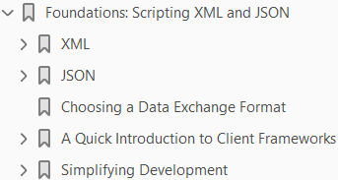
4
Foundations: Scripting XML and JSON

Slide 69
Intro
It’s time to switch gears and look at code for Ajax web applications.
The most important part of an Ajax application is
the connection between
the client and
the server
If this code is not solid and optimized, your application could suffer sluggish (or simply broken) behavior as a result.
You code the connection between the client and the server
using JavaScript, and
usually build the data format used to exchange information in XML
I say usually because a new format is on the rise and is fast becoming the new choice for web developers.
This new format is JavaScript Object Notation (JSON)
In this chapter, we will explore how to use XML and JSON to transmit data.
We will also discuss how the client and the server can parse or otherwise manipulate these formats.
Of course, a discussion of this nature would be incomplete without some points on the differences among browser versions, and how to make cross-browser-compatible code.

Slide 70
XML
We will start with XML, as it is part of the original meaning of Ajax. This section will cover the basics of how Ajax works and what to do with the XML that is sent back and forth between the client and the server. First, driving the Ajax component of an Ajax web application is the XMLHttpRequest object. This object allows for asynchronous communication between the client and the server. In other words, the client can start communicating with the server, and instead of the client freezing up and becoming unusable until that communication is complete, the client can continue to function like normal.
(Page 68).

Slide 71
JSON
JSON is a data exchange format that is a subset of the object literal notation in JavaScript. It has been gaining a lot of attention lately as a lightweight alternative to XML, especially in Ajax applications. Why is this? Because of the ability in JavaScript to parse information quickly using the eval( ) function. JSON does not require JavaScript, however, and you can use it as a simple exchange format for any scripting language. Here is an example of what JSON looks like:
(Page 86).

Slide 72
Choosing a Data Exchange Format
I have shown you how to make Ajax calls between the client and the server with both XML and JSON. So which one should you use? I could tell you that you should use JSON because it is lightweight and easy to use on the client. Or, I could tell you that you should use XML because it is better able to describe data when complicated data sets are moved back and forth between the client and the server. I could tell you these things, but I am not going to. The fact is that it really is up to the developer and the situation that she is in. That’s not to say that you cannot make an informed opinion once I show you the facts about both XML and JSON. One of the arguments for JSON is that it is lightweight in nature. Earlier I said I would tell you whether the JSON example or the XML example was smaller in byte size: the JSON example contains 248 bytes (count them yourself if you like), whereas the XML example contains 240 bytes. So much for JSON being lightweight compared to XML. In reality, the complexity and size of the data being exchanged determines which format is smaller in size. Another argument for JSON is that it is easier to read by both humans and machines. It is true that it takes less time to parse through JSON than XML; thus, JSON is easier for the machine to “read.” It can actually take longer to eval( ) a JSON string than to create a DOM Document object depending on the size of the data. Based on this, you could say that for machines, it is a wash. But what about humans? I think that is a matter of developer opinion. Beauty is in the eye of the beholder, after all. Here are some arguments for XML. XML works as a good data exchange format for moving data between similar applications. XML is designed to have a structure that describes its data, enabling it to provide richer information. XML data is self-describing. XML supports internationalization of its data. XML is widely adopted by the technology industry.
(Page 92).

Slide 73
A Quick Introduction to Client Frameworks
Earlier in the chapter, I used the Sarissa library to aid in XSLT and XPath development. Sarissa is one of many frameworks available for Ajax and JavaScript. It would not be practical to highlight all of them, but in this section I will cover a few of the most popular.
(Page 94).

Slide 74
Simplifying Development
In general, frameworks are meant to ease the grunt work developers usually have to perform when building a foundation before beginning to code. Frameworks allow developers to jump right into the important functional parts of the application they are working on. Beyond that, good foundation frameworks such as Prototype also speed up the time it takes to program through the classes and functions they offer. In this section, we will explore some of the ways these foundations help with Ajax application programming, and how they will crop up throughout the rest of this book.
(Page 97).

Slide 75
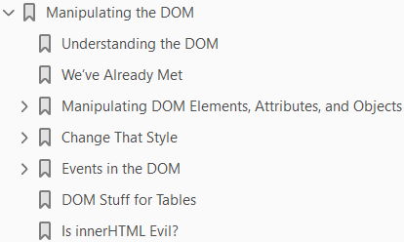
5
Manipulating DOM

Slide 76
Intro
Having an efficient method to send a request to the server and pull back its response without having to refresh the whole page is very important.
It is only a small part of Ajax development, though.
What is more important to any Ajax web application is what is done with the data the client receives.
There’s a lot more work to do than just
grabbing the data
formatting it, and
setting it equal to the innerHTML of an element
Understanding how the HTML Document Object Model (DOM) works and how to manipulate it is of utmost importance.
I like to think that this—manipulating the DOM—is where the magic of Ajax actually happens.
This is what gives
Ajax life and
allows application development on the Web
The first key to understanding how the DOM works is to examine the structure of a DOM object.
Then it will become clearer how the methods allow you to manipulate the DOM.

Slide 77
Understanding the DOM
The structure of any DOM object is its document tree.
The document tree is made up of
branches and
Leaves
Let’s look at a simple XHTML document, shown in Example 5-1, to clarify.
(Page 103).

Slide 78
We’ve Already Met
The methods that most greatly facilitate DOM Document object traversal might seem a little familiar, as you already met them in Chapter 4. These are getElementById( ) and getElementsByTagName( ). Add to these the Prototype library’s helper functions, and we have a good foundation for accessing specific elements on a document tree. Just to refresh, here are some common ways to access specific elements:
(Page 105).

Slide 79
Manipulating DOM Elements, Attributes, Objects
Elements are the containers of all the data to be dynamically altered in an Ajax application. They can contain other elements, which contain still others, or they can simply hold a text node with data for the client. When we talk about these elements, we also want to discuss groups of them represented in document fragment objects. To round out this discussion on elements and objects, we will also consider text elements, since the value of these elements is the data in the application. Our discussion cannot center on just XHTML, either. You could need to alter XML received from a server response just as often as you need to alter the client’s page DOM. We will follow the W3C’s DOM Level 2Recommendation (the standard methods that are available to a developer from the browser) when discussing methods available to a DOM Document object unless I specify otherwise. This allows you to write more robust code utilizing the power of the DOM, instead of writing workarounds for functionality that may be needed in only a particular area.
(Page 106).

Slide 80
Change That Style
Just as methods and properties are available to developers to manipulate elements, attributes, and objects, so too are methods and properties available to manipulate the styles on a page programmatically. The methods and properties I describe here are part of the W3C’s Recommendation for the DOM. Note that Internet Explorer does not follow the W3C Recommendation for stylesheets in the DOM. I will cover this later in the chapter, in the section “What About Internet Explorer?” When stylesheets are loaded into the DOM, whether it is by a <link> or a <style> element on the page, each rule that is imported has a rule type associated with it (see Table 5-8). The DOM can then access all of the imported rules and manipulate them according to the developer’s designs.
(Page 117).

Slide 81
Events in the DOM
The ability to manipulate events on the client is central to Web 2.0 and Ajax web applications. Whether it is a user moving the mouse over an object on the application, or typing some text, or clicking on a button, the events that fire from these actions are paramount to having any client-application interaction. All client events are broken out by Event modules. These modules are as follows:
(Page 129).

Slide 82
DOM Stuff for Tables
XHTML tables have methods and properties that the other XHTML elements do not have. These special methods and properties are specifically designed for manipulating parts of the table in a more precise manner. To use these methods and properties, however, you must think of a table in the full XHTML specification. An XHTML table contains a <caption>, a <thead>, a <tfoot>, and any number of tbodies:
(Page 135).

Slide 83
Is innerHTML Evil?
The innerHTML property has caused much debate since Microsoft introduced it for Internet Explorer all those years ago. There are usually only two camps on this issue: those that support it wholeheartedly and those that believe it is evil. So, the question that needs to be answered is “Is innerHTML evil?”
(Page 138).

Slide 84
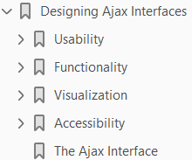
6
Designing Ajax Interfaces

Slide 85
Intro
At this point, we have examined the basics of what it takes to create Ajax web applications—the standards that are used, the design patterns to follow, the server-side languages available, the frameworks, and the Document Object Model (DOM) methods and properties used to fetch data and manipulate the DOM. However, we have not discussed how to design the interface to your application. Just as important as the tools that go into building an application are the components that make up the user interface. The interface is how the end user (your main focus) interacts with and uses the application you have designed. Unless you design the interface with the user in mind from the beginning, parts of your application may be cumbersome to navigate, agitating people and discouraging them from using your Ajax web application in the future. Fortunately, there are ways to prevent this from happening. In addition to the general rules we created more than 15 years ago for desktop applications, other suggestions and guidelines were created specifically for web interfaces. With these as your guide, you should have no problems designing an interface that people find useful and enjoy interacting with. Designing Ajax interfaces covers four distinct yet related components: usability, functionality, visualization, and accessibility. By considering each component and the nuances they bring, you will design and create an application that users find intuitive, user-friendly, and easy to navigate.
(Page 141).

Slide 86
Usability
The usability of an Ajax web application refers mainly to how easy the application is to navigate and manipulate, and how intuitive it is to the end user. If an application is usable, it is: • Structured • Simple • Tolerant
(Page 141).

Slide 87
Functionality
Functionality refers to the features in an Ajax application that support a given task. The application’s functionality is directly related to its success on the Internet. If your application does not contain the functionality that web users have come to expect as standard, it cannot succeed. Going beyond what is standard and porting desktop functionality to the Web will set your application apart. Applications provide different types of functionality with the tools they use. Table 6-1 lists the different function types that can appear in an application.
(Page 153).

Slide 88
Visualization
Visualization is all about the look of the application. It concerns creating an application that is aesthetically pleasing and that visually keeps the user’s interest, while avoiding any potential distractions by including unnecessary components. Although it can be tempting to add “bells and whistles” to an application just because you can, they will only distract from the application and should be included only if the client has requested them.
(Page 158).

Slide 89
Accessibility
Accessibility in web design is a hot topic, and for good reason. The Internet was born only recently, and now gives us unprecedented access to information, news, entertainment, and commerce at our fingertips—so much so that most of us cannot imagine life without the Web.
(Page 167).

Slide 90
The Ajax Interface
What does all this have to do with Ajax applications? Everything. An Ajax application encompasses all of these different ideas—usability, functionality, visualization, and accessibility. An Ajax application should follow all of these web design issues, as all of these are important for any application on the Web. Remember what I said in Chapter 2, though: Ajax has its place. Do not force an application to have an Ajax interface just to say that it has one. You should use Ajax when it is necessary or required. You are defeating the purpose of its very design if you do not follow this and instead create an application that is not usable or functional, is visually unappealing, or has accessibility issues. A good example of an Ajax design working on the Web is Gmail, found at http:// www.gmail.com/. Figure 6-14 shows what the application looks like from the browser.
(Page 171).

Slide 91
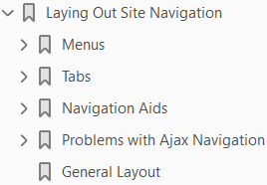
7

Slide 92
Intro

Slide 93
8

Slide 94
Intro

Slide 95
9

Slide 96
Intro

Slide 97
10

Slide 98
Intro

